Slide 1
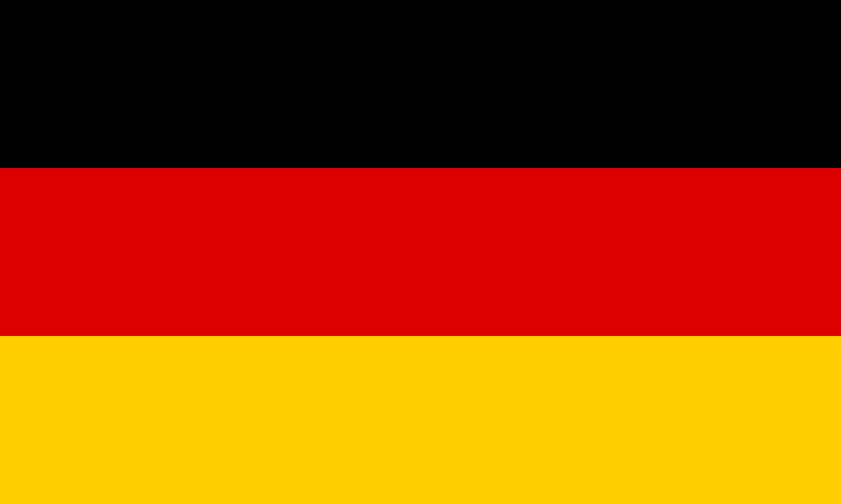
German name day
Made by: Sebestény Martin, Erdős Ádám, Adrián Glück,Turóczi Patrik , Szász Gergő

Slide 2
About website
This application was created to make German name day celebrations more accessible. Our goal is to represent the importance of German names and to ensure that this important cultural tradition continues to exist.
Many European countries have name days, such as Germany or Croatia.
Some names were created based on the feast day of a saint in the church, so This is a tradition in many countries in Europe.

Slide 3
Functions
Search engine:
We created the search engine to make it easier to search for names and to enable someone to look up when their name day is . We made this section in JavaScript.
Show name days:
This section shows immediately which name has its name day today and which one will have it soon. We made this section in JavaScript.
Fun Facts:
This section presents interesting facts about German names, such as which one is the longest or the shortest.

Slide 4
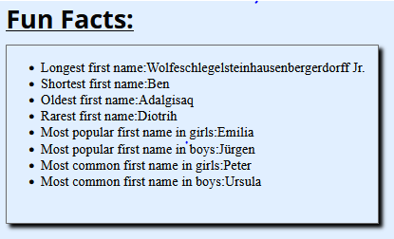
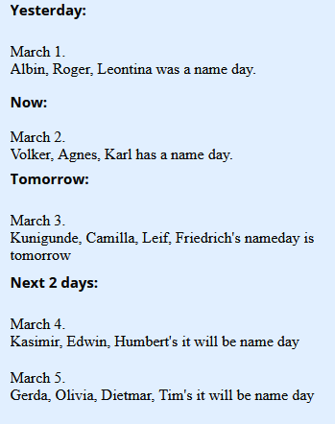
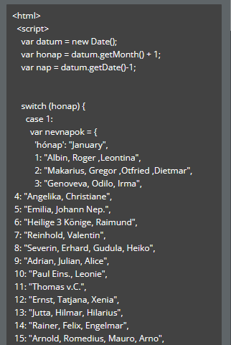
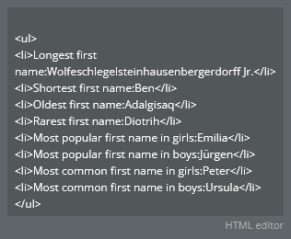
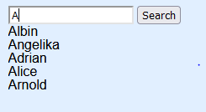
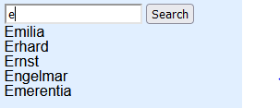

Slide 5
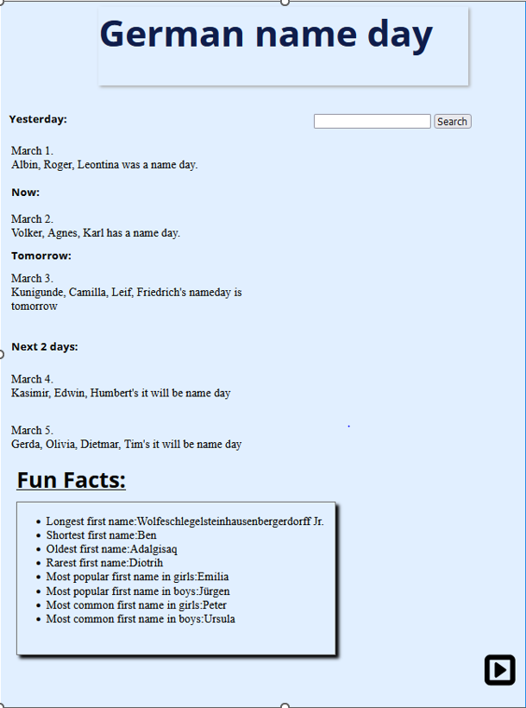
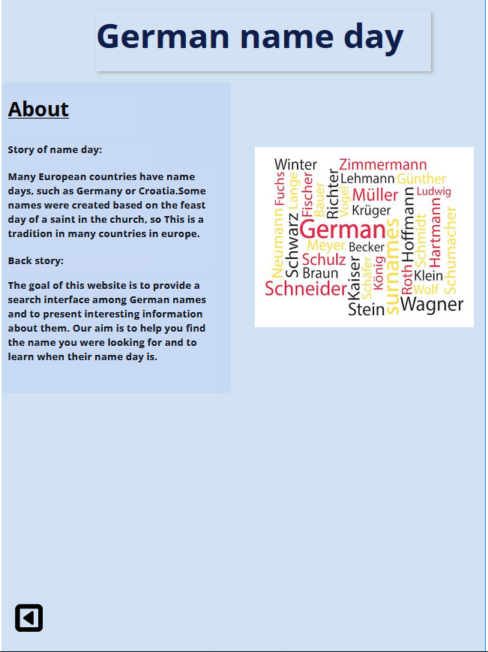

Slide 6
Thank you for a attention!

